Slide 1

VOICE BASED PHOTO ALBUM SEARCH
DONE BY:
S.V.N.Sai Varun – 19BCE7092
A.V. Avinash – 19BCE7389
Submitted To:
Dr. Arun Kumar Gopu.

Slide 2
CONTENTS:
DESCRIPTION
INNOVATION
SERVICES USED
ARCHITECTURE DIAGRAM
PROCESS
USECASE
OUTCOME

Slide 3
DESCRIPTION:
"Voice Based Photo Album Search" is a serverless, microservice driven web-based application
The user can visit the photo album application, search photos using natural language via voice and text, see relevant results based on what user searched and can upload new photos and see them appear in the search results.
This application uses Lex, ElasticSearch, and Rekognition to create an intelligent search layer to query your photos for people, objects, actions, landmarks and more.

Slide 4
INNOVATION:
Today in this new generation many things are going voice based. So, here in our project the relevant result which we need is getting on Voice based.

Slide 5
Services Used:
AWS SERVICES
AWS S3 BUCKET:
Amazon Simple Storage Service (Amazon S3) is an object storage service that offers industry-leading scalability, data availability, security, and performance.
AWS LEX:
Amazon Lex is a fully managed artificial intelligence (AI) service with advanced natural language models for building conversational interfaces into applications such as Build virtual agents and voice assistants ,Automate informational responses ,and Improve productivity with application bots.
AWS LAMBDA :
AWS Lambda is a serverless compute service that lets you run code without provisioning or managing servers, creating workload-aware cluster scaling logic, maintaining event integrations, or managing runtimes. With Lambda, we ran code for the application with zero administration.

Slide 6
AWS API GATEWAY:
Amazon API Gateway is a fully managed service that makes it easy for developers to create, publish, maintain, monitor, and secure APIs at any scale. APIs act as the "front door" for applications to access data, business logic, or functionality from your backend services. Using API Gateway, we were able to create RESTful APIs for the chatbot which communicate with the lambda functions.
AWS ELASTICSEARCH :
AWS Elasticsearch is a distributed search and analytics engine built on Apache Lucene. Since its release in 2010, Elasticsearch has quickly become the most popular search engine and is commonly used for log analytics, full-text search, security intelligence, business analytics, and operational intelligence use cases.
AWS TRANSCRIBE :
Amazon Transcribe makes it easy for developers to add speech to text capabilities to their applications. Audio data is virtually impossible for computers to search and analyze. Therefore, recorded speech needs to be converted to text before it can be used in applications.

Slide 7
AWS RECKOGNITION:
Amazon Rekognition makes it easy to add image and video analysis to your applications. You just provide an image or video to the Amazon Rekognition API, and the service can identify objects, people, text, scenes, and activities. It can detect any inappropriate content as well.
AWS CODE PIELINE :
AWS CodePipeline is a fully managed continuous delivery service that helps you automate your release pipelines for fast and reliable application and infrastructure updates. CodePipeline automates the build, test, and deploy phases of your release process every time there is a code change, based on the release model you define.
Speed up cloud provisioning with infrastructure as code. AWS CloudFormation lets you model, provision, and manage AWS and third-party resources by treating infrastructure as code.

Slide 8
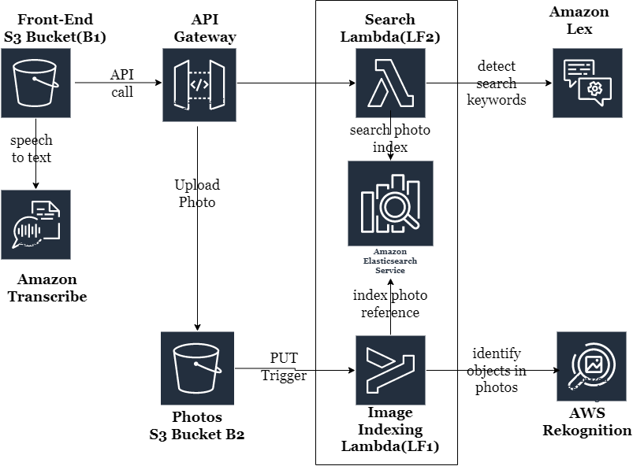
ARCHITECTURE DIAGRAM:

Slide 9
Process:
The Search query from the user is sent to AWS Lex which identifies the keywords from the query and searched the Elastic Search for the indices. If there is a match then it will return all the images that matched the search query. The search query can be text that the user enters or it can be a voice note where we would use AWS Transcribe to convert speech to text and then use the text for the search query.
The Upload workflow takes an image from the user local system and uploads it directly to S3 and then uses AWS rekognition to index the image which is later stored in Elastic search.

Slide 10
USECASE
If user knows the topic and user doesn’t know that particular photo
then by using this NLP user can get the needed photo

Slide 11
OUTCOME:
Visit your photo album application using the S3 hosted URL.
Search photos using natural language via voice and text.
See relevant results (ex. If you searched for a cat, you should be able to see photos with cats in them) based on what you searched.
Upload new photos and see them appear in the search results.

